Slide 1
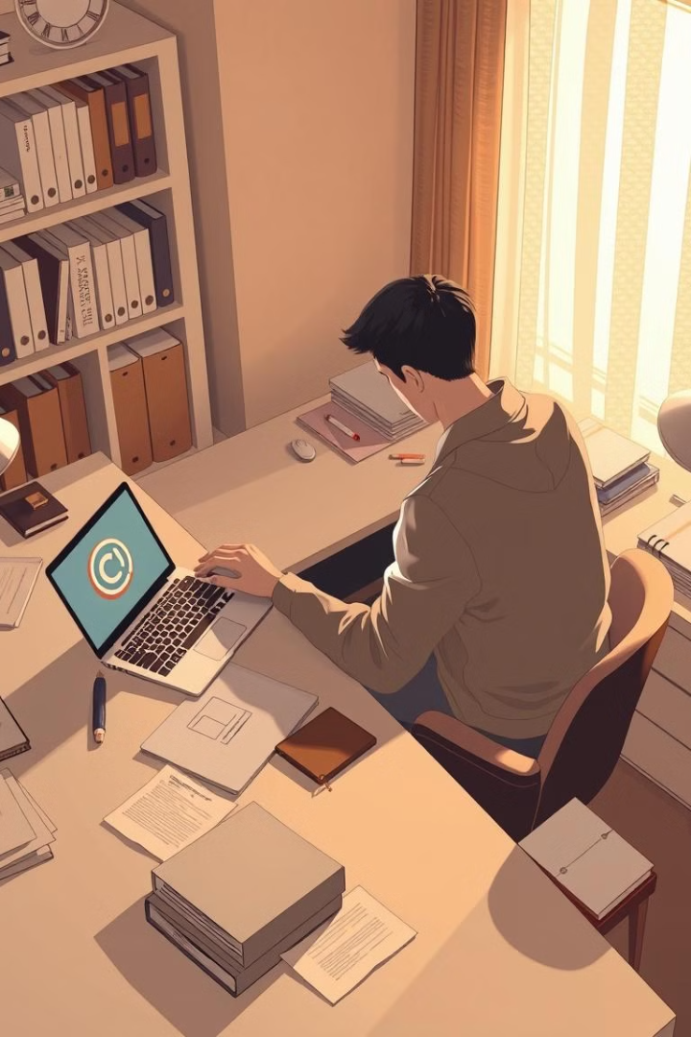

Copyright, Strike, and Intellectual Property
This presentation explores the concepts of copyright, strike, and intellectual property, providing insights into their importance in the digital age. We will delve into the legal protections granted to creators and the mechanisms used to enforce these rights, particularly within the context of social media platforms like Facebook.
by Akbar Hossan

Slide 2

Copyright: Protecting Creative Works
Copyright is a legal protection granted to creators of original works, such as literature, music, films, artwork, and software. It gives creators exclusive rights over the use and distribution of their work, allowing them to earn recognition or financial compensation for their creations.
Reproduction
The right to make copies of the work, including digital copies.
Distribution
The right to sell or license copies of the work to others.
Public Performance
The right to publicly perform or display the work, such as in a concert or exhibition.
Derivative Works
The right to create new works based on the original, such as a movie adaptation of a book.

Slide 3
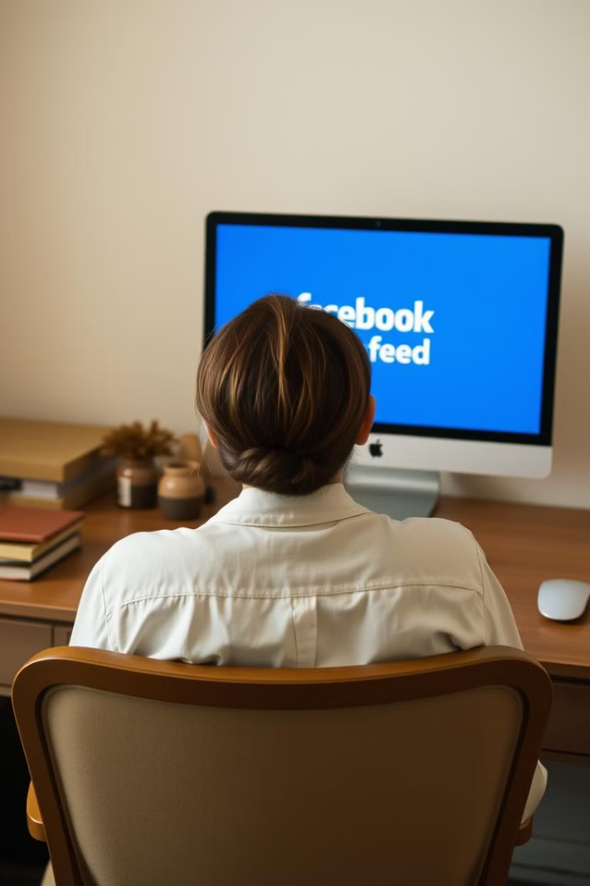
Facebook's Copyright Manager
Facebook's Copyright Manager is a tool designed to help content creators and rights holders protect and manage their intellectual property on the platform. It provides an easy way for creators, especially those who produce a high volume of original content, to monitor and control how their copyrighted material is used across Facebook and Instagram.
1
Reference Library
Rights holders can upload their copyrighted material to the platform's reference library.
2
Monitoring
Creators can monitor how their content is being used on Facebook and Instagram.
3
Control
Creators can take action to prevent misuse of their copyrighted material.
4
Monetization
Creators can explore monetization opportunities for their content.

Slide 4
Intellectual Property: A Broad Concept
Intellectual property (IP) refers to creations of the mind, such as inventions, literary and artistic works, designs, symbols, names, and images used in commerce. It is a legal concept that grants creators and inventors exclusive rights to use and benefit from their creations, offering protection similar to physical property.
Types of IP
Benefits of IP
Responsibilities
Patents, trademarks, copyrights, and trade secrets are all forms of intellectual property.
IP laws encourage innovation and creativity by ensuring that individuals and organizations can control and profit from their intellectual efforts.
IP rights must be legally registered and enforced, and they have time limits after which the work enters the public domain.

Slide 5
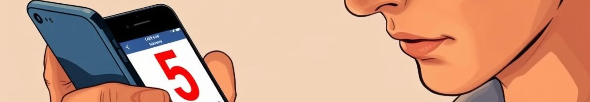



Reporting Content on Facebook
Reporting content on Facebook is a way for users to notify the platform about posts, comments, profiles, or other content that violates Facebook's Community Standards. These standards are designed to ensure a safe and respectful environment for users.
Identify Violation
Report Content
Facebook Review
Encounter content that you believe violates Facebook's Community Standards.
Report the content to Facebook for review.
Facebook will review the reported content and take appropriate action.

Slide 6
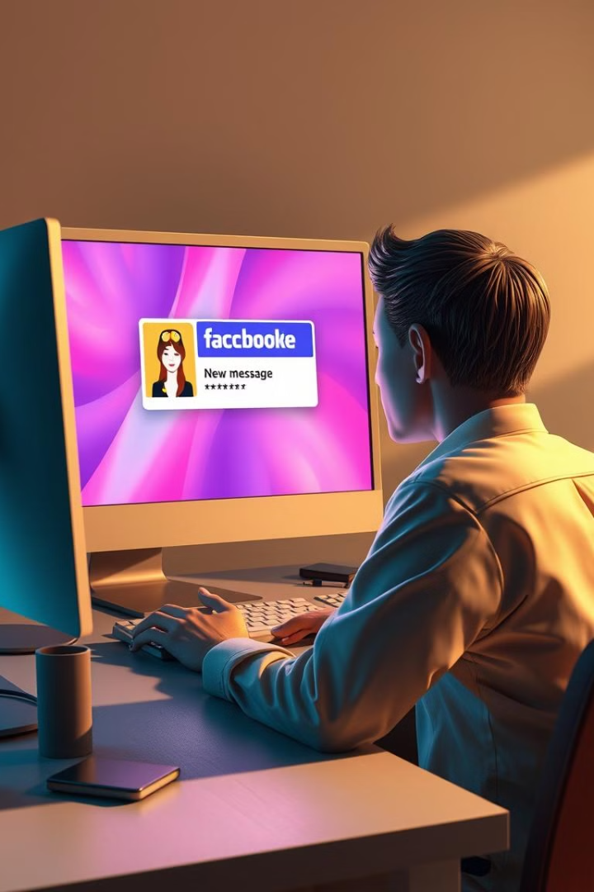
Facebook Strikes: Consequences of Violations
A Facebook strike, commonly referred to as a "Community Standards Violation," occurs when you post content that violates Facebook's guidelines or policies. These strikes are part of Facebook's efforts to maintain a safe and respectful environment on its platform.
Strike Level
Consequences
1st Strike
Warning
2nd Strike
Account Restrictions
3rd Strike
Temporary Suspension
4th Strike
Permanent Ban

Slide 7
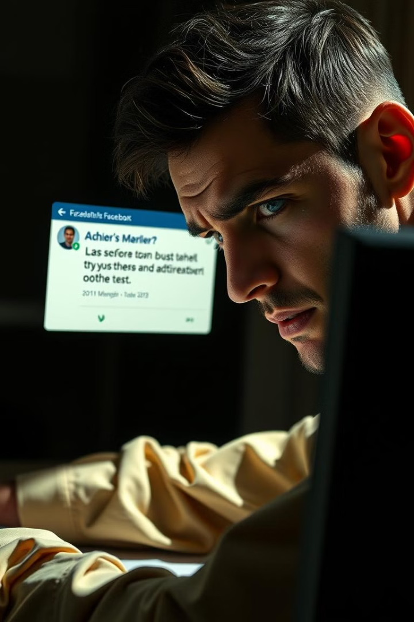



Impact of Strikes on Facebook Presence
Accumulating strikes can affect your Facebook presence. Strikes may reduce the visibility of your posts, limit access to certain features (like ads or groups), or ultimately result in a permanent ban.
Reduced Visibility
Your posts may reach fewer people.
Feature Restrictions
You may lose access to certain features.
Account Suspension
Your account may be temporarily or permanently suspended.

Slide 8
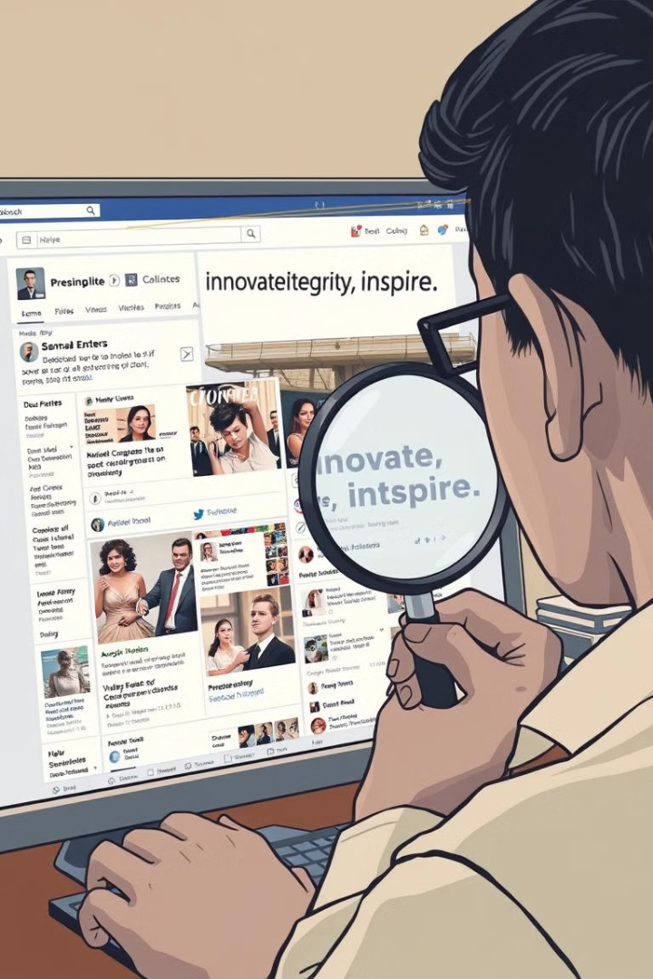
Preventing Harmful Content
Facebook may also take actions to prevent harmful or misleading content from spreading, such as reducing its reach in the news feed. This helps ensure that users are exposed to accurate and trustworthy information.
1
Content Identification
Facebook uses algorithms and human reviewers to identify harmful content.
2
Reach Reduction
Harmful content may be shown to fewer people.
3
Removal
In extreme cases, harmful content may be removed from the platform.

